Slide 1

GRAPH THEORY AND ITS APPLICATIONS
Dr. Arti Arya
Department of Computer Science & Engineering

Slide 2

GRAPH THEORY AND ITS APPLICATIONS
TREES
Dr. Arti Arya
Department of Computer Science & Engineering

Slide 3
Graph Theory and its Applications Acknowledgement
The inputs to the slides are by Dr. Surabhi Narayan and by Dr. Arti Arya. The sources of the information other than text book is mentioned wherever used.

Slide 4
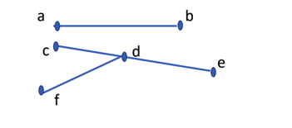
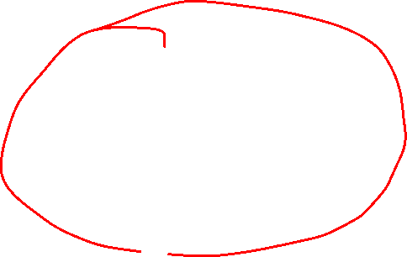
Graph Theory and its Applications Trees
Let G=(V,E) be a loop free undirected graph, then the graph G is said to be a tree if G is connected and contains no cycles.
G
If each component of a disconnected graph is a tree, then the graph is called a forest.

Slide 5
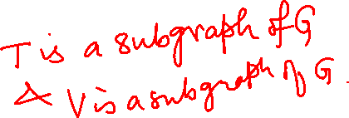
Graph Theory and its Applications
Spanning Trees
A subgraph T of graph G is called a spanning tree of G if
T is a tree and
T contains all vertices of the graph G
G
T
V

Slide 6
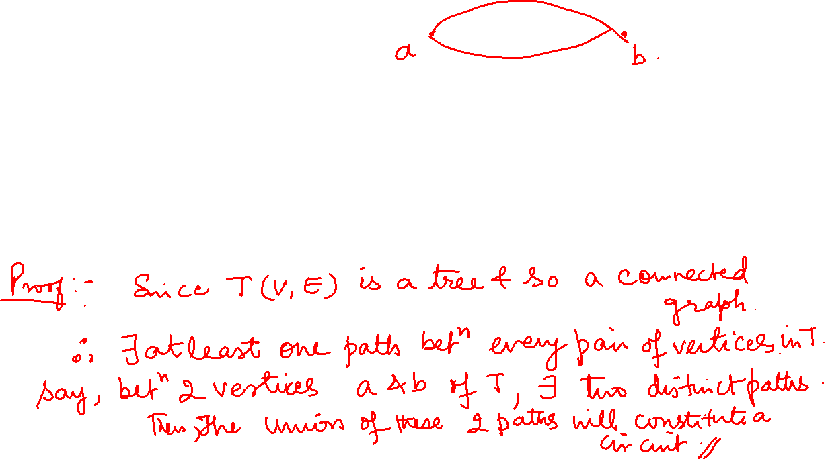
Graph Theory and its Applications
Some Properties of Trees
Theorem
If a and b are distinct vertices in a Tree T(V,E); then there is a unique path that connects these vertices
OR
There is one and only one path between every pair of vertices in a tree.

Slide 7
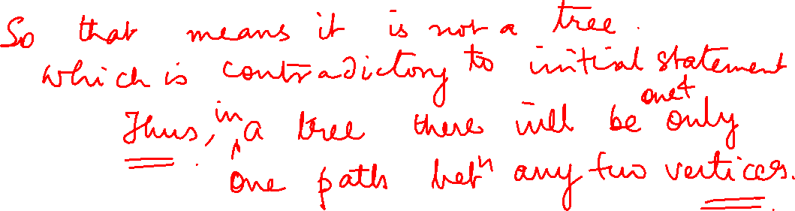

Slide 8
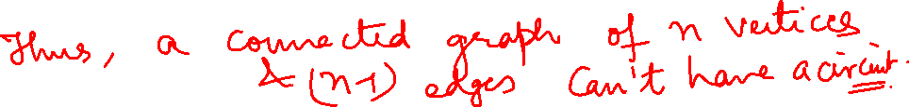
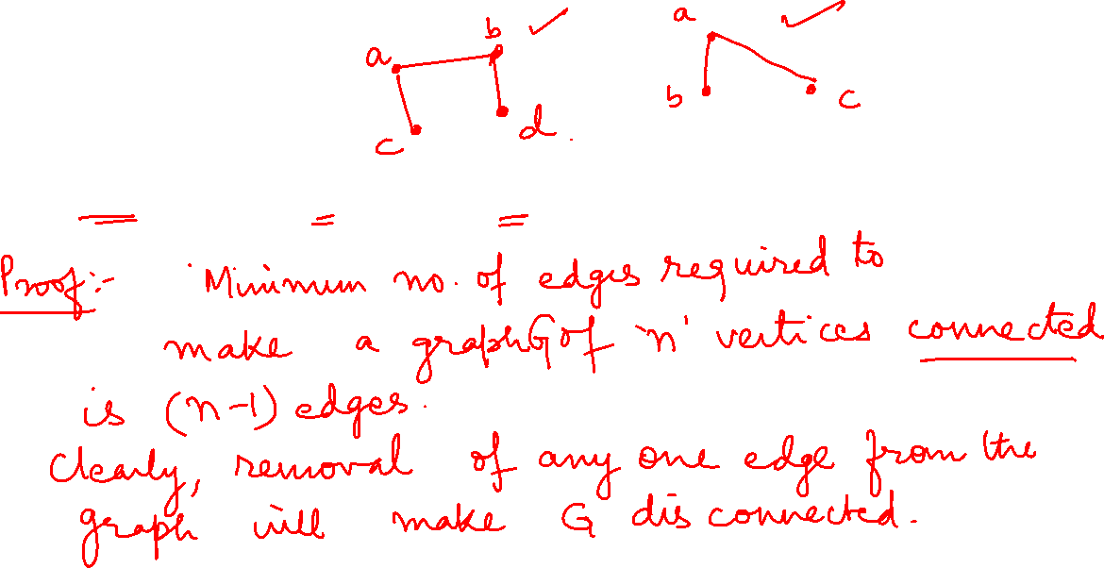
Graph Theory and its Applications Some Properties of Trees
Theorem
Any connected graph with n vertices and n-1 edges is a tree.

Slide 9
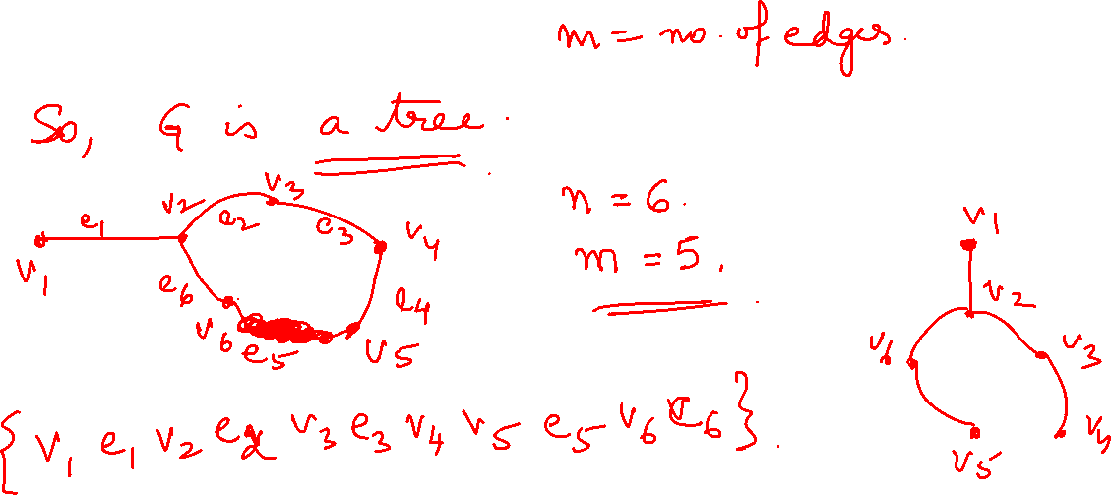

Slide 10
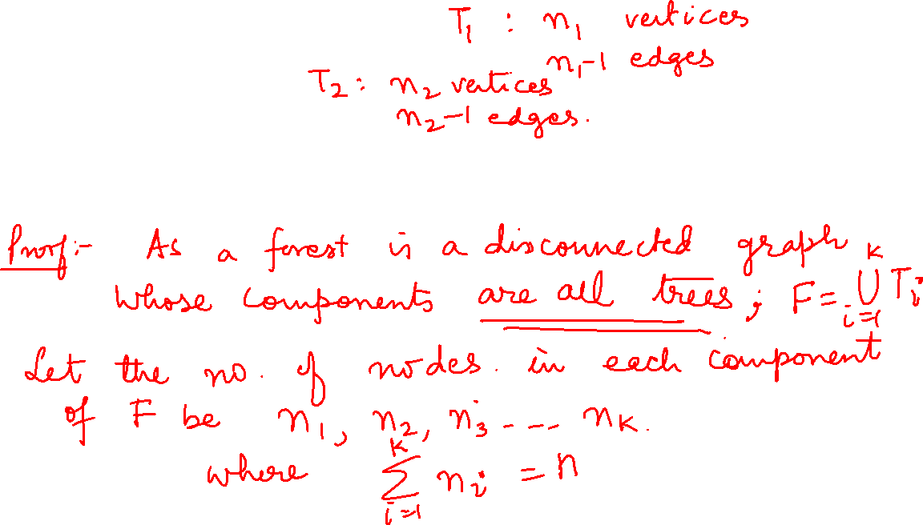
Graph Theory and its Applications
Some Properties of Trees
Theorem
Let F be a forest with k components (trees), if n is the number of vertices, m is
the number of edges in F, then prove that n=m+k

Slide 11
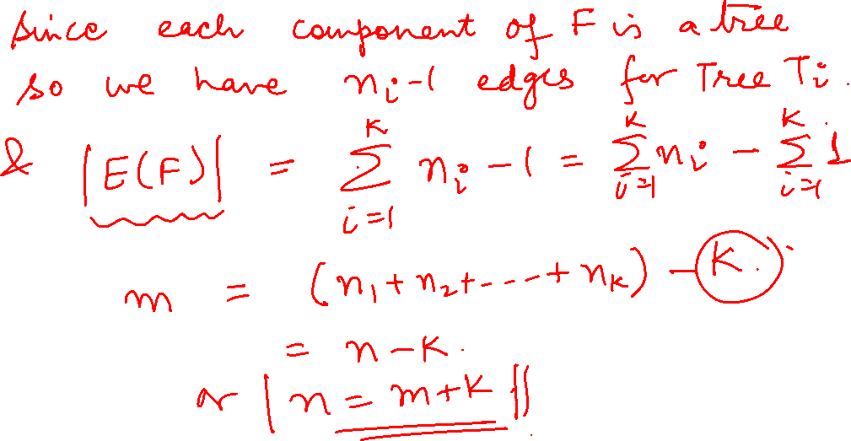

Slide 12
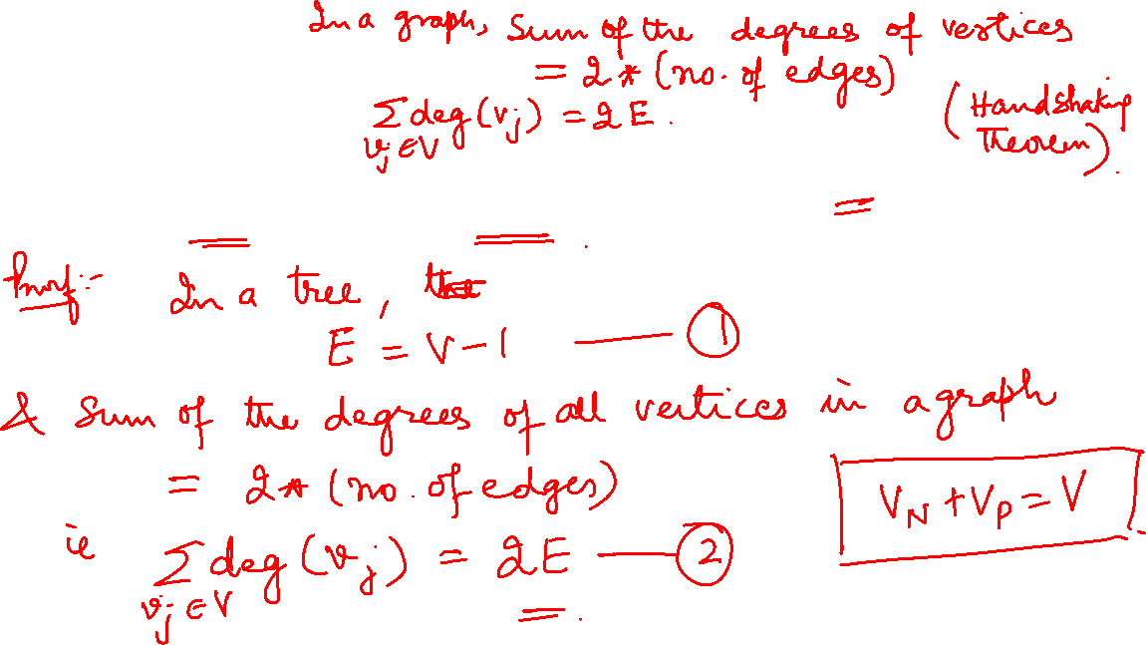
Graph Theory and its Applications
Some Properties of Trees
Show that in a tree, if the degree of every non pendant vertex is 3, then the no. of vertices in the tree is an even number.

Slide 13
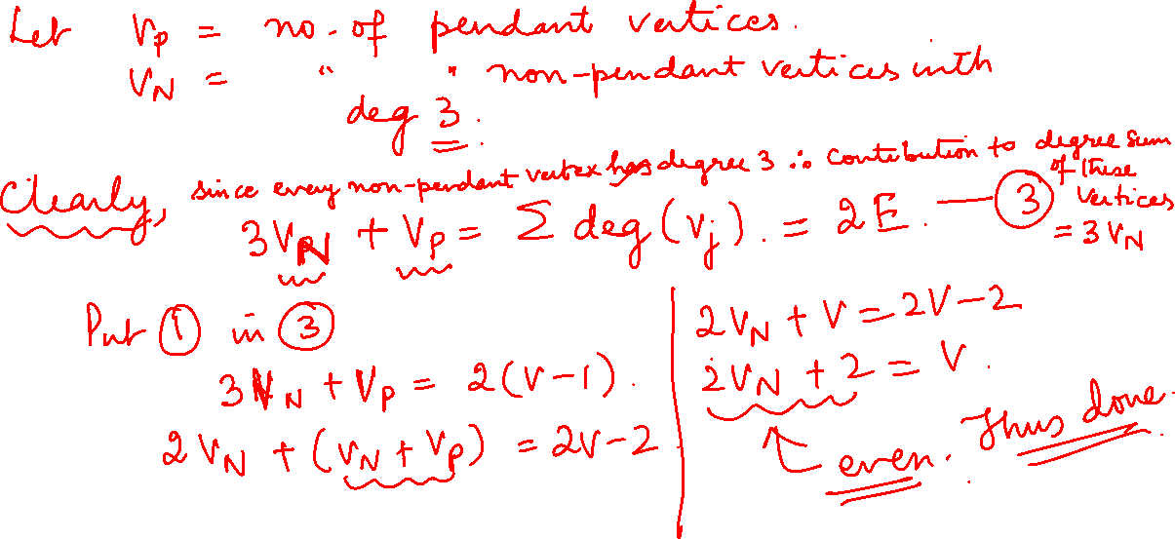

Slide 14

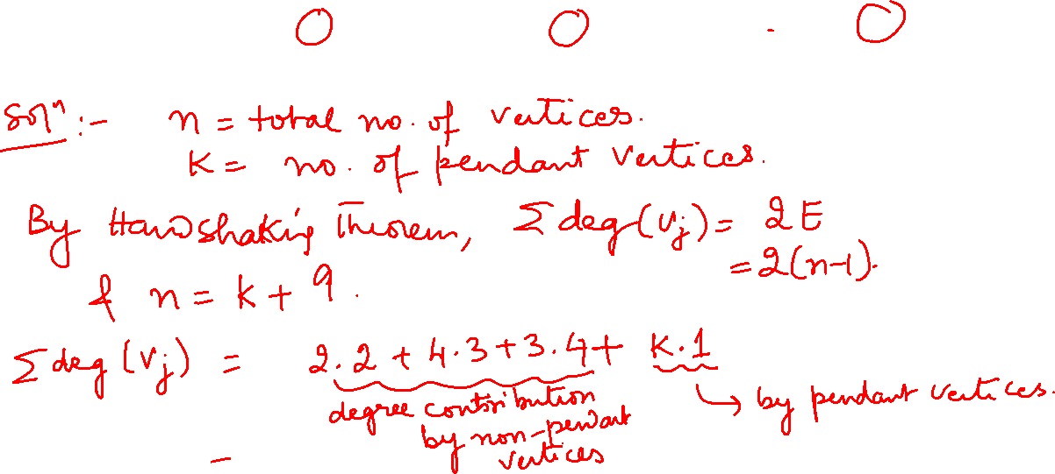
Graph Theory and its Applications
Some Properties of Trees
Suppose that a tree T has 2 vertices of degree 2, 4 vertices of degree 3 and 3 vertices of degree 4. find the number of pendant vertices in T.

Slide 15
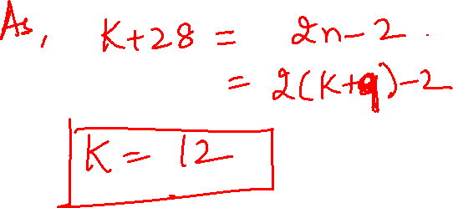

Slide 16
Graph Theory and its Applications
Some Properties of Trees
If a tree T has 4 vertices of degree 2, 1 vertex of degree 3 and 2 vertices of degree 4 and 1 vertex of degree 5. find the number of pendant vertices in T.

Slide 17
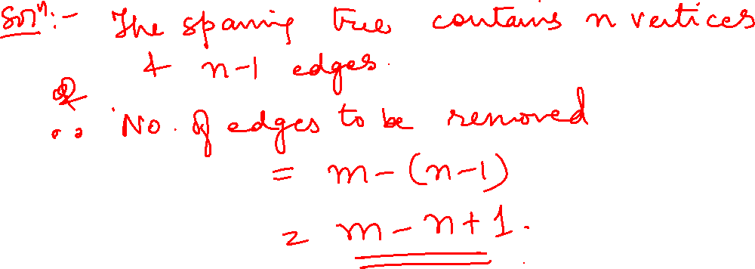
Graph Theory and its Applications
Some Properties of Trees
How many edges must be removed from a connected graph with n vertices and m edges to produce a spanning tree.

Slide 18
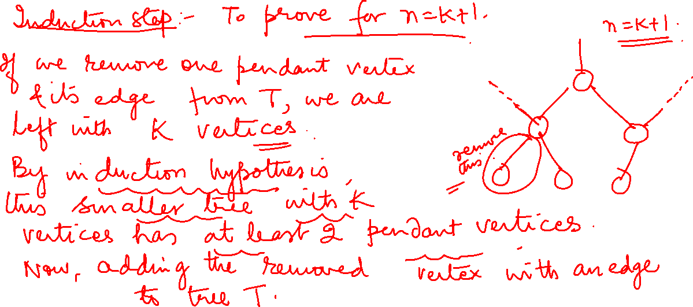

Slide 19
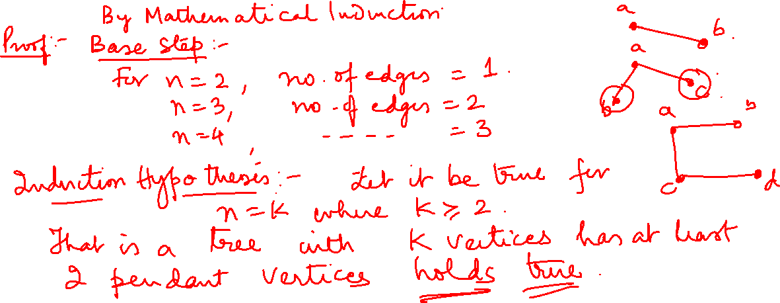
Graph Theory and its Applications
Some Properties of Trees
Prove that in a tree T with 2 or more vertices, there are atleast 2 pendant vertices

Slide 20
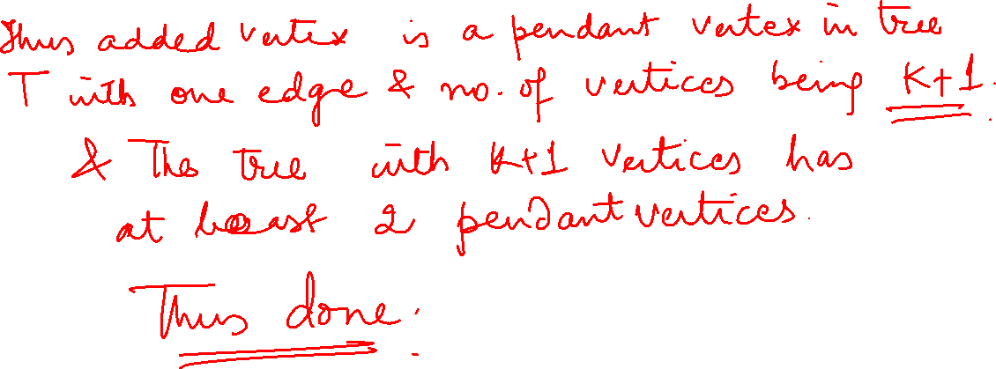

Slide 21
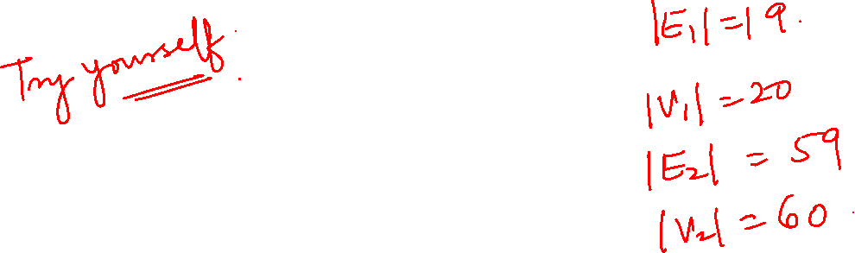
Graph Theory and its Applications
Some Properties of Trees
Let T₁ = (V₁ , E₁) and T₂ = (V₂, E₂) be 2 trees. If |E₁| = 19 and |V₂| = 3 *| V₁|
then determine |V₁|, |V₂| and |E₂|

Slide 22
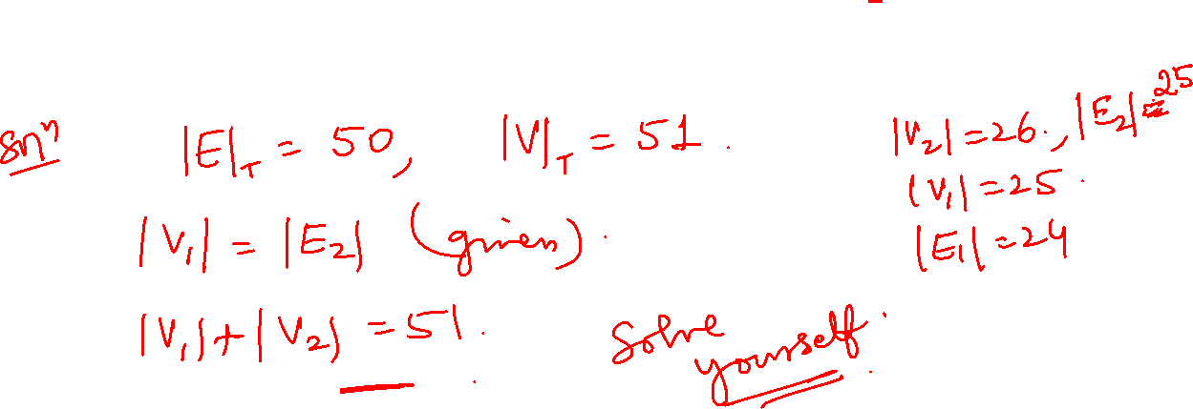
Graph Theory and its Applications
Some Properties of Trees
Let T be a tree with 50 edges. The removal of certain edge from T yields 2 disjoint trees T₁ and T₂ given that the number of vertices in T₁ equals to the number of edges in T₂. Determine the number of vertices and number of edges in T₁ and T₂

Slide 23
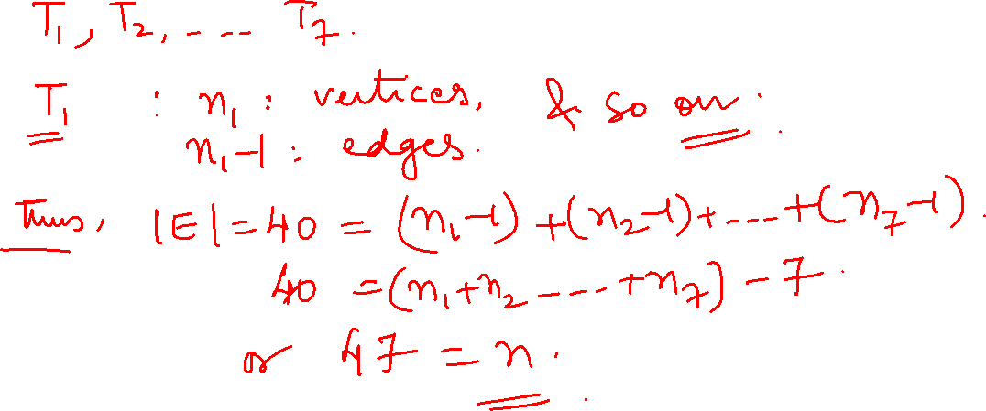
Graph Theory and its Applications
Some Properties of Trees
Let F = (V,E) be a forest of seven trees where |E| = 40 Determine |V|

Slide 24
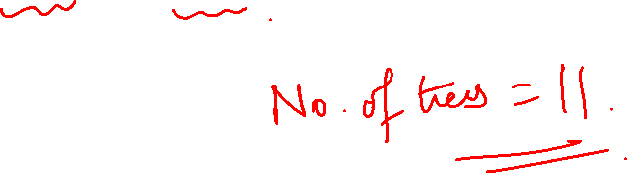
Graph Theory and its Applications
Some Properties of Trees
Let F= (V,E) be a forest with |V|=62 and |E|=51, how many trees determine F.

Slide 25
Graph Theory and its Applications Trees
Minimum Spanning Tree
Let G(V,E) be a graph and there is a weight/cost associated with each edge of G. Then G is called a weighted graph and the positive real number associated with an edge e is called the weight of the edge e.
Let T be a spanning tree of this graph G. The sum of all weights of all the branches is called the weight of tree T.
A spanning tree whose weight is the least is called a Minimal Spanning Tree(MST) of the graph.

Slide 26
Graph Theory and its Applications Trees
Minimum Spanning Tree
There are several methods of constructing Minimal Spanning Tree.
Kruskal’s Algorithm
Prim’s Algorithm
Boruvka’s Algorithm
Reverse Delete Algorithm

Slide 27
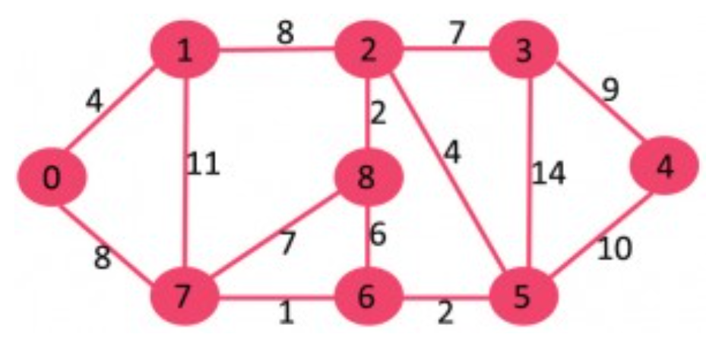
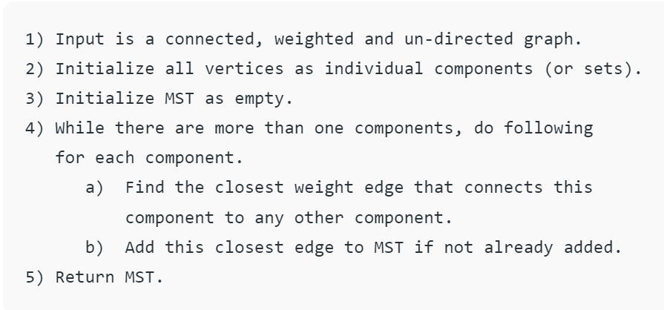
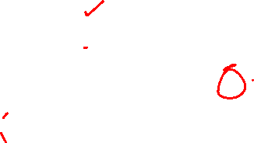
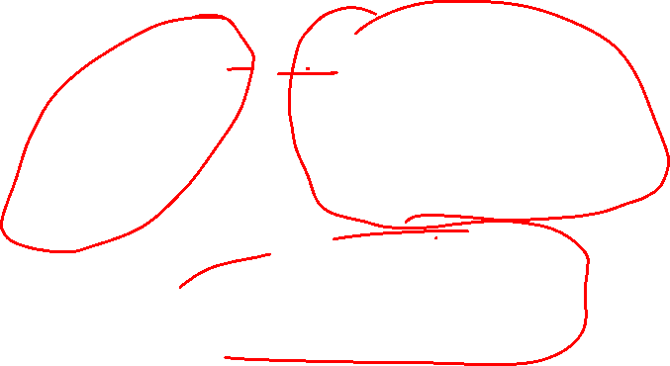
Graph Theory and its Applications Minimum Spanning Tree: Apply Bourvka’s Algorithm
https://www.geeksforgeeks.org/boruvkas-algorithm-greedy-algo-9/

Slide 28
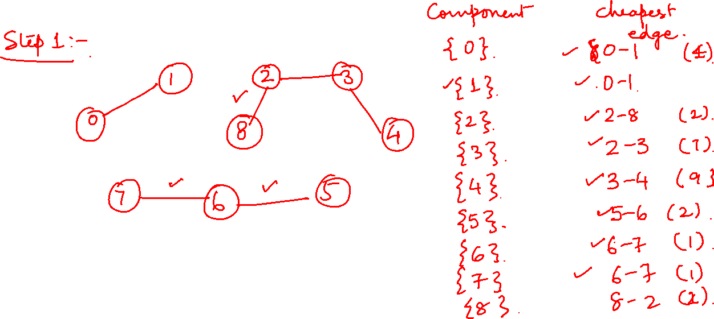
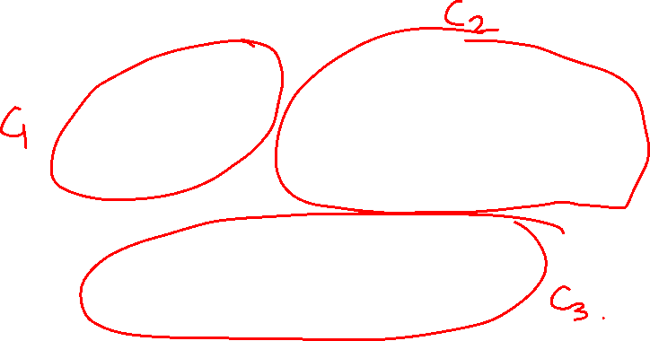

Slide 29
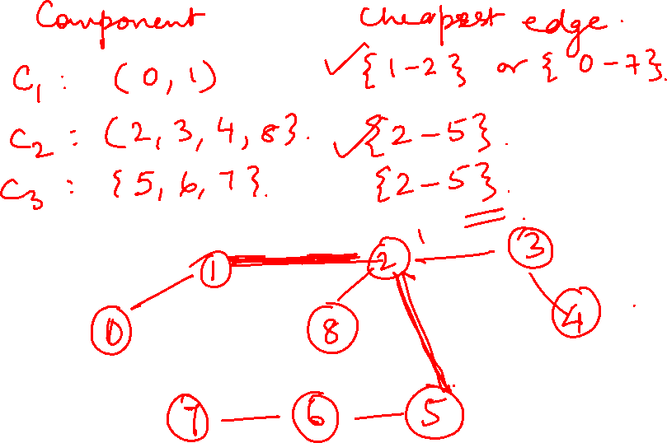







Slide 30
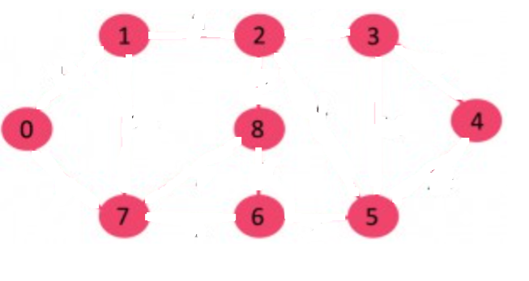
Graph Theory and its Applications Minimum Spanning Tree: Apply Bourvka’s Algorithm
https://www.geeksforgeeks.org/boruvkas-algorithm-greedy-algo-9/

Slide 31
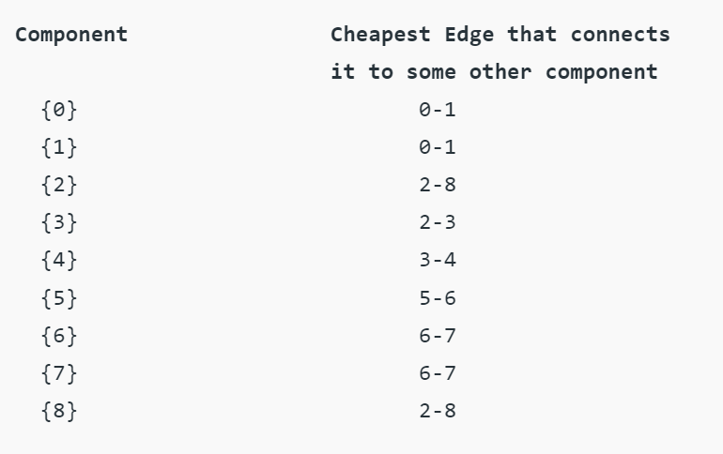
Graph Theory and its Applications Minimum Spanning Tree: Apply Bourvka’s Algorithm
https://www.geeksforgeeks.org/boruvkas-algorithm-greedy-algo-9/

Slide 32
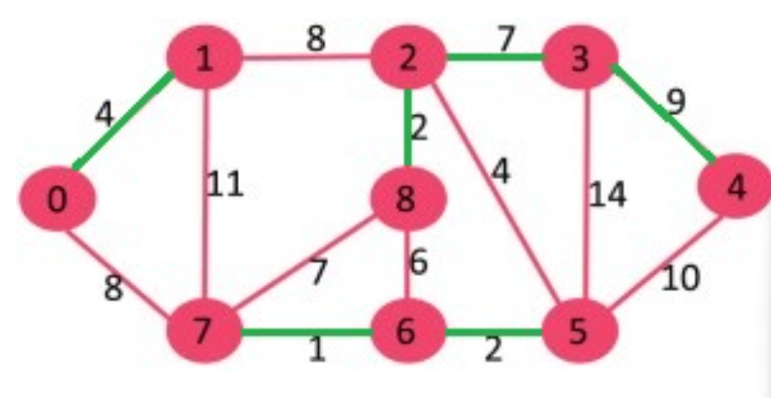
Graph Theory and its Applications Minimum Spanning Tree: Apply Bourvka’s Algorithm
https://www.geeksforgeeks.org/boruvkas-algorithm-greedy-algo-9/

Slide 33
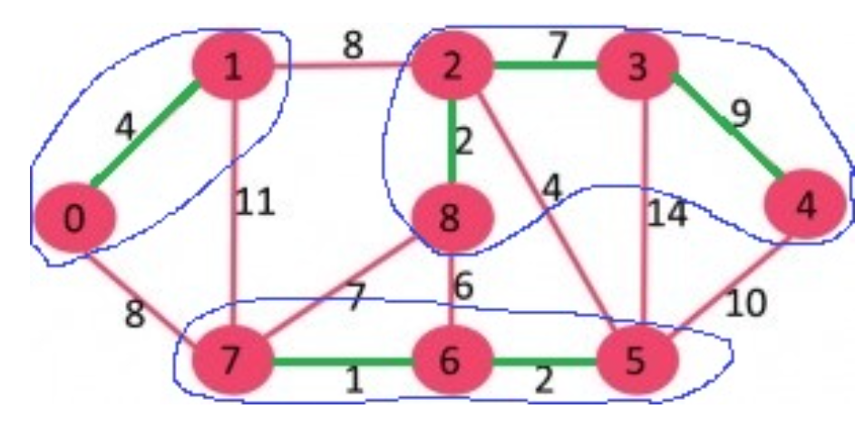
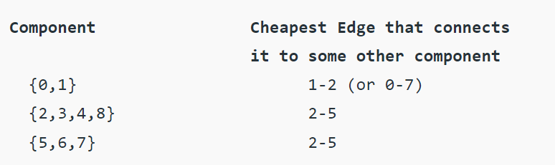
Graph Theory and its Applications Minimum Spanning Tree: Apply Bourvka’s Algorithm
https://www.geeksforgeeks.org/boruvkas-algorithm-greedy-algo-9/

Slide 34
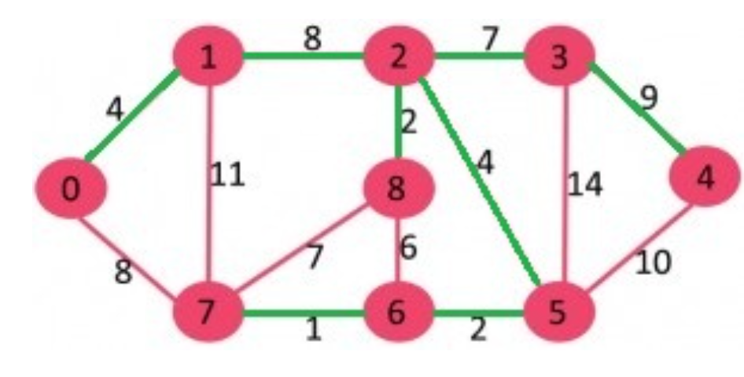
Graph Theory and its Applications Minimum Spanning Tree: Apply Bourvka’s Algorithm
The input graph is represented as a collection of edges and Union-Find Data structure is used to keep track of components.
https://www.geeksforgeeks.org/boruvkas-algorithm-greedy-algo-9/

Slide 35
Graph Theory and its Applications Minimum Spanning Tree
a
8
b
6 8 ₄ d | 6 7
4 | 5 4
9
c
e
9
f
6
g

Slide 36
Graph Theory, Applications and Combinatorics Minimum Spanning Tree
0
5
8
9
1
2
10
11
15
3
4
7

Slide 37
Graph Theory, Applications and Combinatorics Minimum Spanning Tree
¹ 2 ³
A ^{B C D}
9
7
8
1
2
E ⁴ F ⁵ G ⁶ H
3
4
4
8 9
5
I
J K
L
6

Slide 38
Graph Theory, Applications and Combinatorics Minimum Spanning Tree
B
14
C
8
22
26
6
11
A
4
D
3
E
2
28
16
5
25
20
F
G
H
10
27
6

Slide 39
Graph Theory, Applications and Combinatorics Minimum Spanning Tree
8
7
1
2
3
9
4
11
4
14
0
8
4
7
8
7
6
5
10
1
2

Slide 40
Graph Theory and its Applications Boruvka’s Algorithm
Input: A connected graph G whose edges have distinct weights
Initialize a forest F to be a set of one vertex trees, one for each vertex of the graph.
While F has more than one component
For each component C of F
Begin with an empty set of edges S
For each vertex V in C
Find the shortest/closest edge from v to a vertex outside of C and add it to S
Add the shortest edge in S to F
Combine trees connected by edges to form bigger components
Output: T is the minimum spanning tree of G
Note that an edge can be selected twice by two different components. No problem in that.

Slide 41
Graph Theory and its Applications Reverse Delete Algorithm
Reverse delete algorithm is closely related to Kruskal’s algorithm.
In Kruskal’s algorithm edges are sorted in increasing order and an edge is included in the spanning tree if it does not result in a cycle and until there are v-1 edges in spanning tree.
In Reverse delete algorithm we sort edges in decreasing order of their weights. The current edge is picked if excluding the current edge does not cause disconnection of the graph.

Slide 42
Graph Theory and its Applications Reverse Delete Algorithm
Sort all edges of graph in non increasing order of edge weights.
Initialize MST as original graph and remove extra edges using step 3.
Pick the highest weight edge from remaining edges and check if deleting the edge disconnects the graph or not. If the graph disconnects then we don’t delete the edge, else we delete the edge and continue.

Slide 43
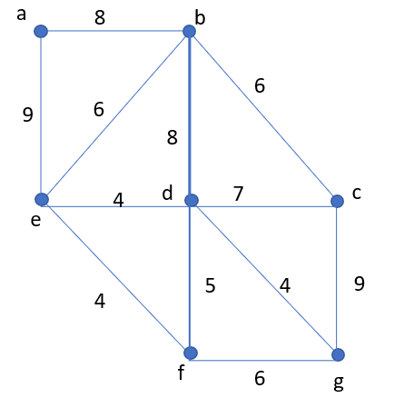
Graph Theory and its Applications Reverse Delete Algorithm

Slide 46
Graph Theory and its Applications Reverse Delete Algorithm

Slide 48
Graph Theory, Applications and Combinatorics Minimum Spanning Tree
8
7
1
2
3
9
4
11
4
14
0
8
4
7
8
7
6
5
10
1
2

Slide 49
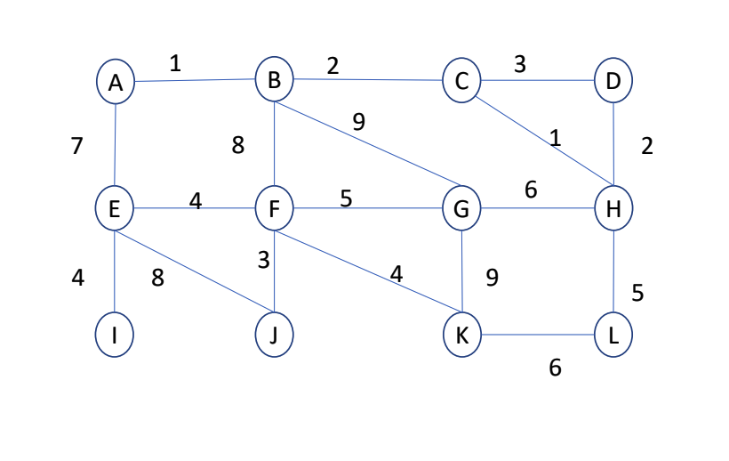
Graph Theory, Applications and Combinatorics Minimum Spanning Tree

Slide 50
Graph Theory, Applications and Combinatorics Minimum Spanning Tree
B
14
C
8
22
26
6
11
A
4
D
3
E
2
28
16
5
25
20
F
G
H
10
27
6

Slide 51
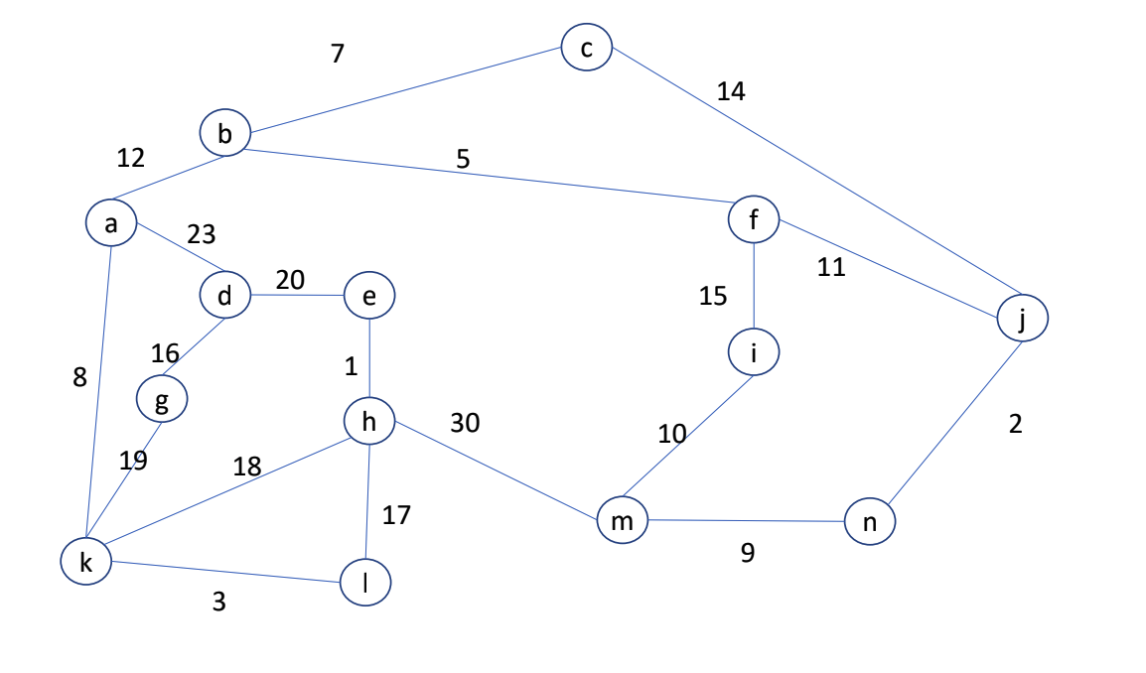
Graph Theory, Applications and Combinatorics Minimum Spanning Tree

Slide 52
THANK YOU
Dr. Arti Arya
Department of Computer Science &Engineering
artiarya@pes.edu

